Slide 1
Designing in 2d with css grid
Presented By:
Venkat Raghava Sampath S533978
Preetham Potu S533713
Gouthami Pasham S533491
Srikanth Yellamati S533715
Rakesh Avirineni S533487

Slide 2
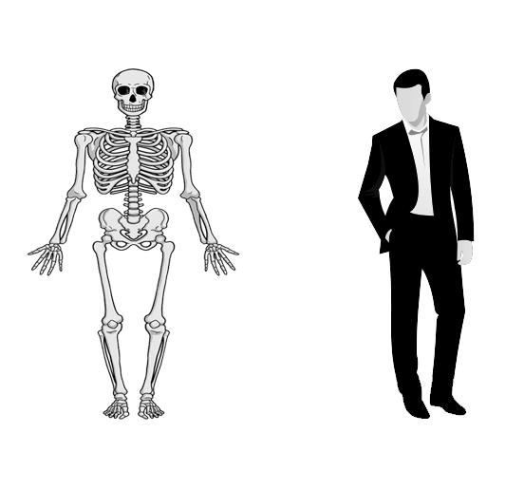
HTML CSS JS

Slide 3
COMPARISIONS OF GRID
2D Transformations:
Translate()
Rotate()
Scale()
SkewX()
SkewY()
Matrix()
3D Transformations:
Translate3D(X,Y,Z)
Scale3D()
Rotate3D()
Matrix3D()

Slide 4

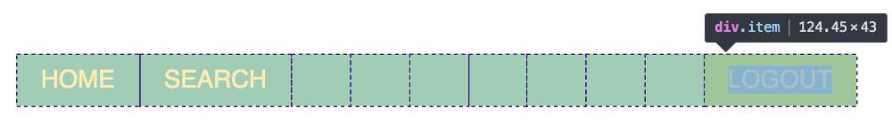
Comparison with flexbox
Flexbox is made for one dimensional layouts.
Grid is made for two dimensional layouts.
Flexbox can design either a row or a column at a time.
Grid can design both rows and columns at the same time.
Example:-

Slide 5
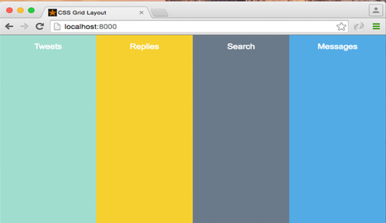
APPLICATIONS OF CSS GRID 2D

Slide 6
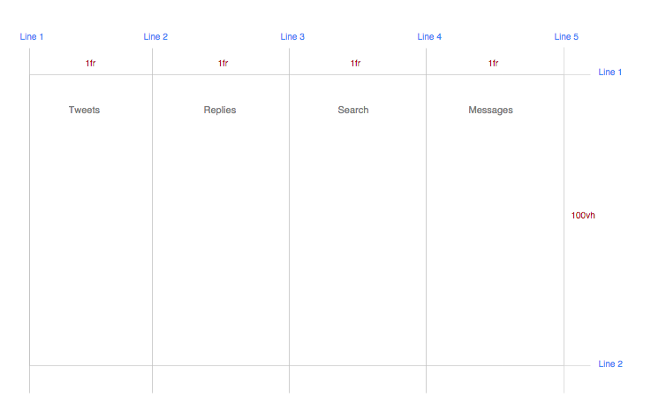
APPLICATIONS OF CSS GRID 2D

Slide 7
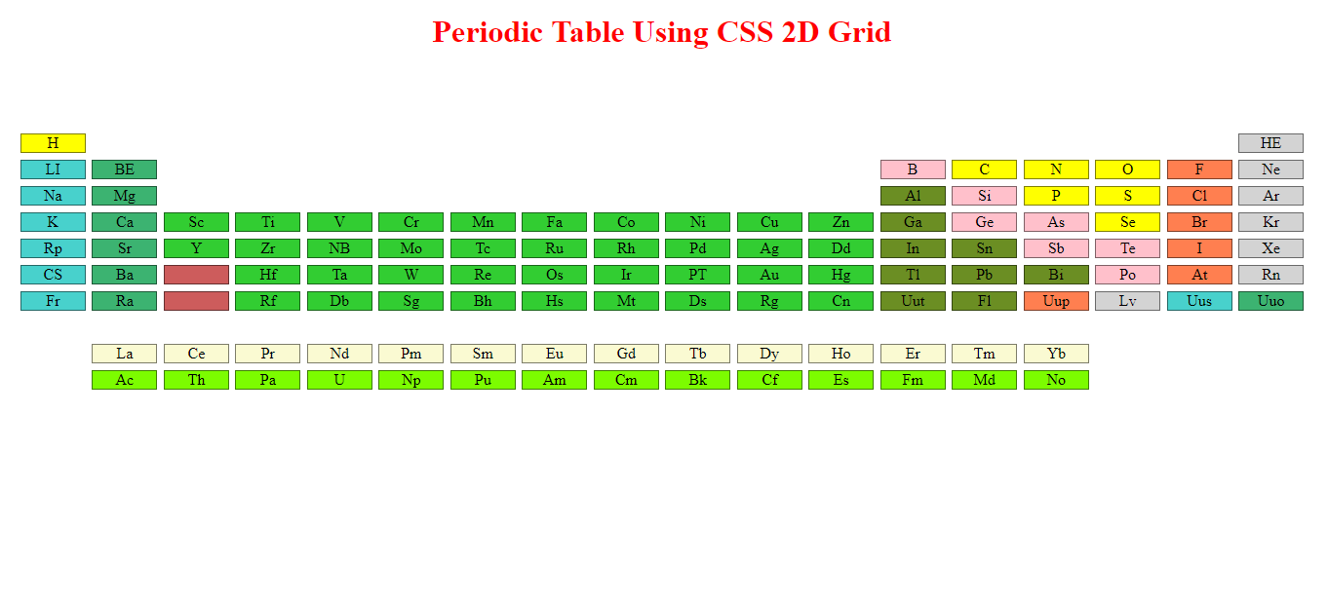

Slide 8
REFERENCES
https://en.wikipedia.org/wiki/Periodic_table
https://www.w3schools.com/css/css_grid.asp
Safari online

Slide 9


